Slide 1

HACK’HER’THON
TEAM SYSTEM ZOMBIES

Slide 2

HAPPY INDEPENDENT LIVING.

Slide 3
PROBLEM STATEMENT :
Multi-Functional Blind Stick for Visually Impaired People
TEAM DETAILS:
LEADER : Oviya Srinivasan INT – III YEAR
Preetha Balaji INT – III YEAR
Raja Rajesvari INT - III YEAR

Slide 4
DESCRIPTION OF SOLUTION :
A white cane is used as a base model and hardware components such as RaspberryPi, camera module, IR sensor, ultrasonic sensor, motors to emulate haptics and buzzer are used to build the advanced smart white cane.
When the user is walking in the streets and when obstacles such as a dog or a car comes in front of them then the camera detects the object and the distance of the object and conveys it to the user immediately so that the user can avoid the obstacles.
When an slope, ridge or any small obstacles that come in the way of the user the ultrasonic sensor detects it and gives a beep sound indicating the same.
Haptic sensors have been employed for ease in navigation for the VIPs
If the user meets with an accident an alert will be sent to the users relative with the GPS location. We have integrated maps for easy navigation.

Slide 5
PROCESS FLOW
AUDIO FEEDBACK & HAPTICS
POTHOLE DETETCTION AND ALERT
DETECTS OBSTACLE
WITH ITS DISTANCE
BY FALL DETECTION
LIVE MAP LOCATION UPDATES
CONSTANT MONITORING BY CARETAKER
ALERT IS SENT TO CARETAKER

Slide 6





TECHNOLOGY STACK

Slide 7
USE CASE
LIVE LOCATION UPDATES
FALL DETECTION
OBSTACLE DETECTION ALONG WITH THE DISTANCE METRICS.
DELIVERED AS A FEEDBACK
AUDIO FEEDBACK VIA BLUETOOTH
HAPTICS TO GUIDE THEM
VIP’S CARETAKER WILL BE ABLE TO TRACK AND MONITOR THEM.
HASHING TECHNIQUES ARE USED FOR SECURE DATA TRANSMISSION AND PROCESSING

Slide 8
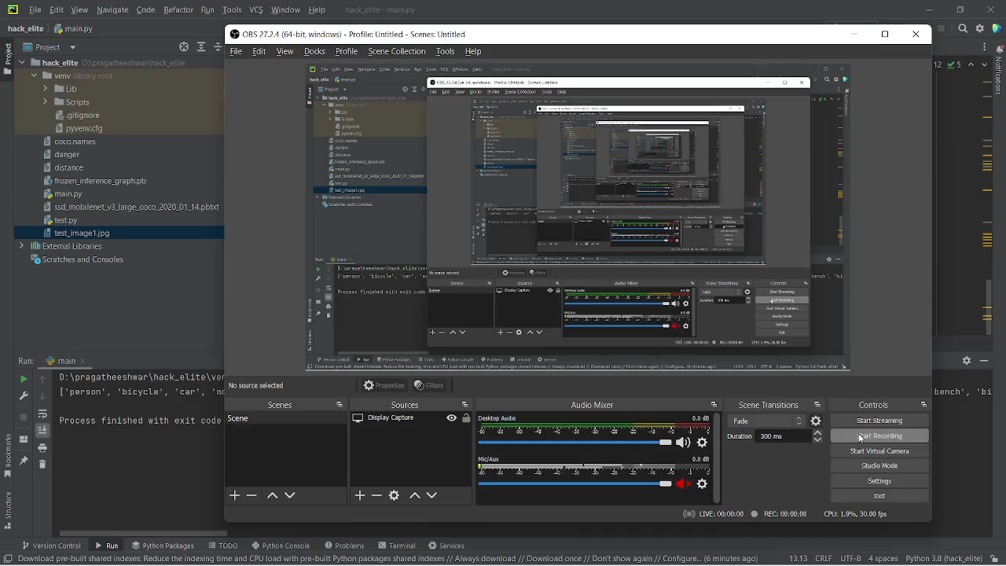
OUTPUT OF DETECTION & AUDIO FEEDBACK

Slide 9
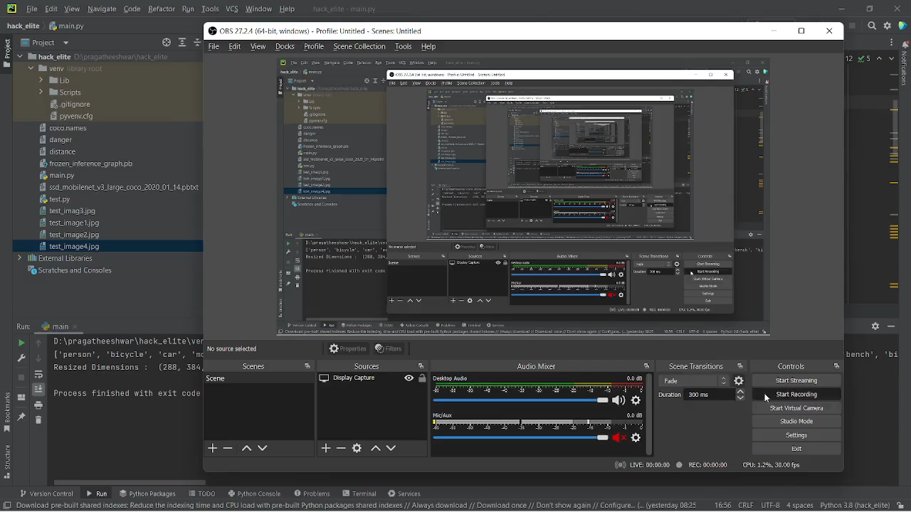
OUTPUT OF DETECTION & AUDIO FEEDBACK

Slide 10
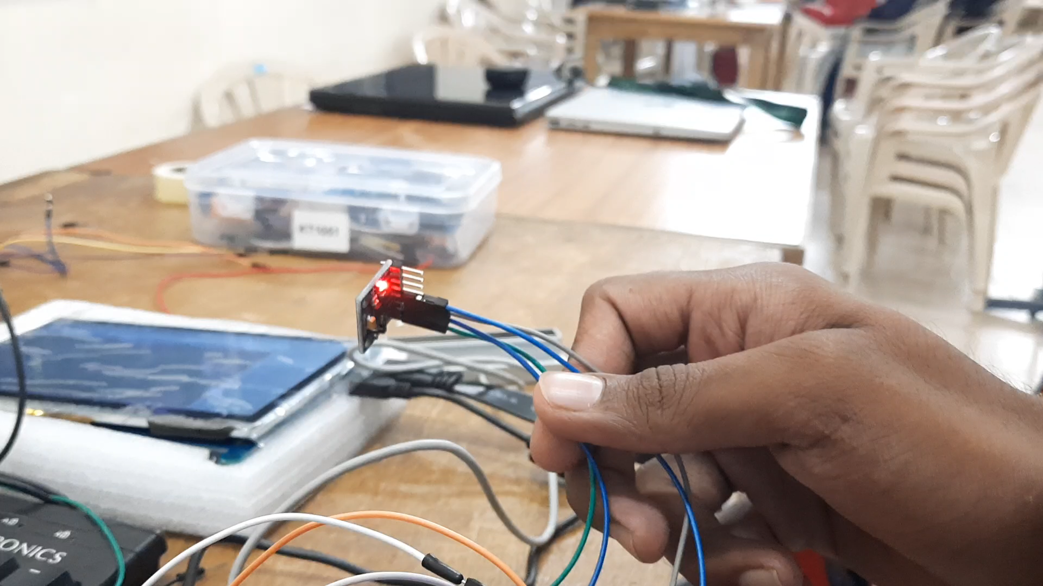
FALL DETECTION

Slide 11
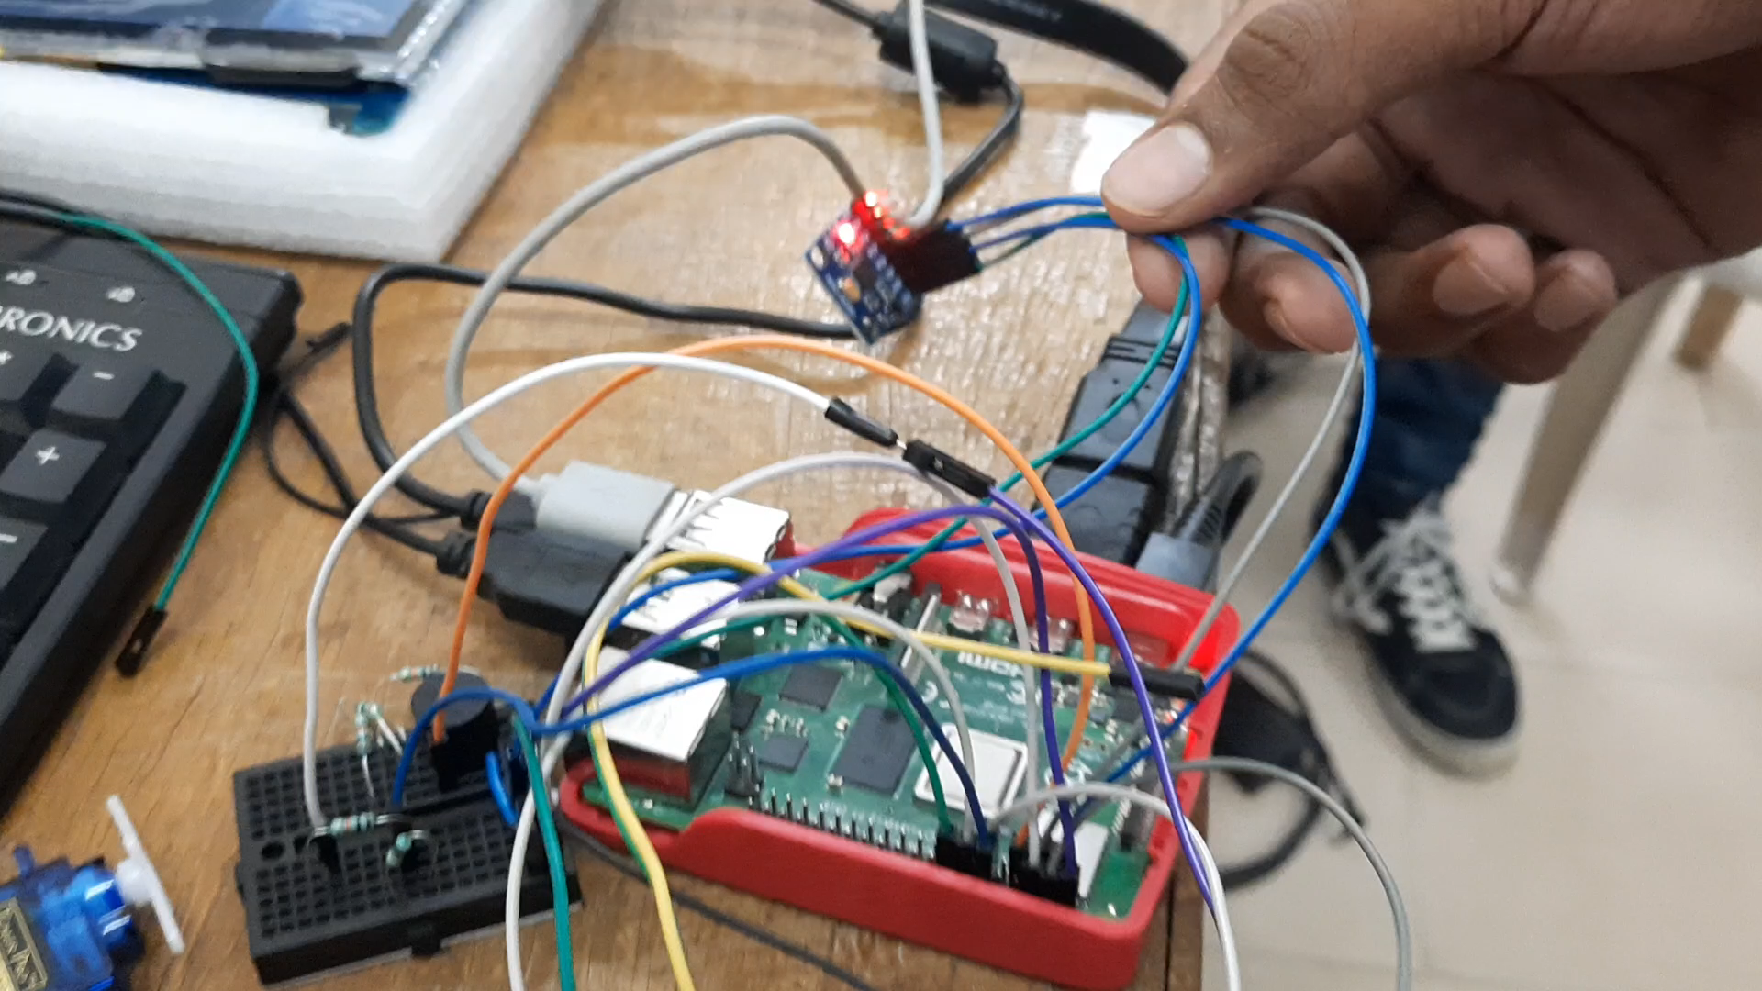
FALL DETECTION

Slide 12
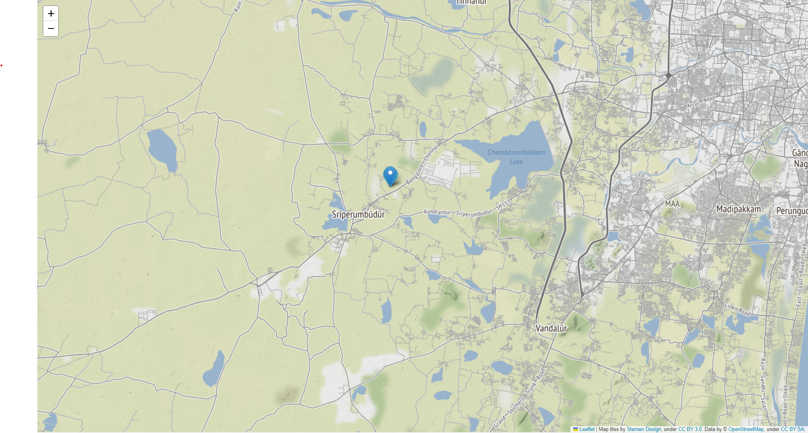
INTEGRATING MAPS

Slide 13
OUR COMPETITORS
WEWalk : A Turkish based smart cane , which is now a part of the Microsoft Cloud partner program
It cost’s you $599 which is about 49,000 INR
SmartCane : An IIT-D incubated device which provides a ultrasonic sensing with a vibration pattern output.
It’s priced at 3000 INR.

Slide 14
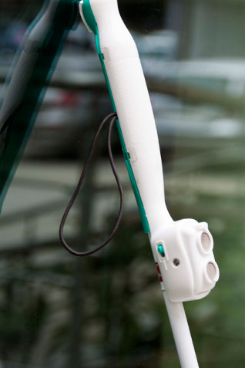
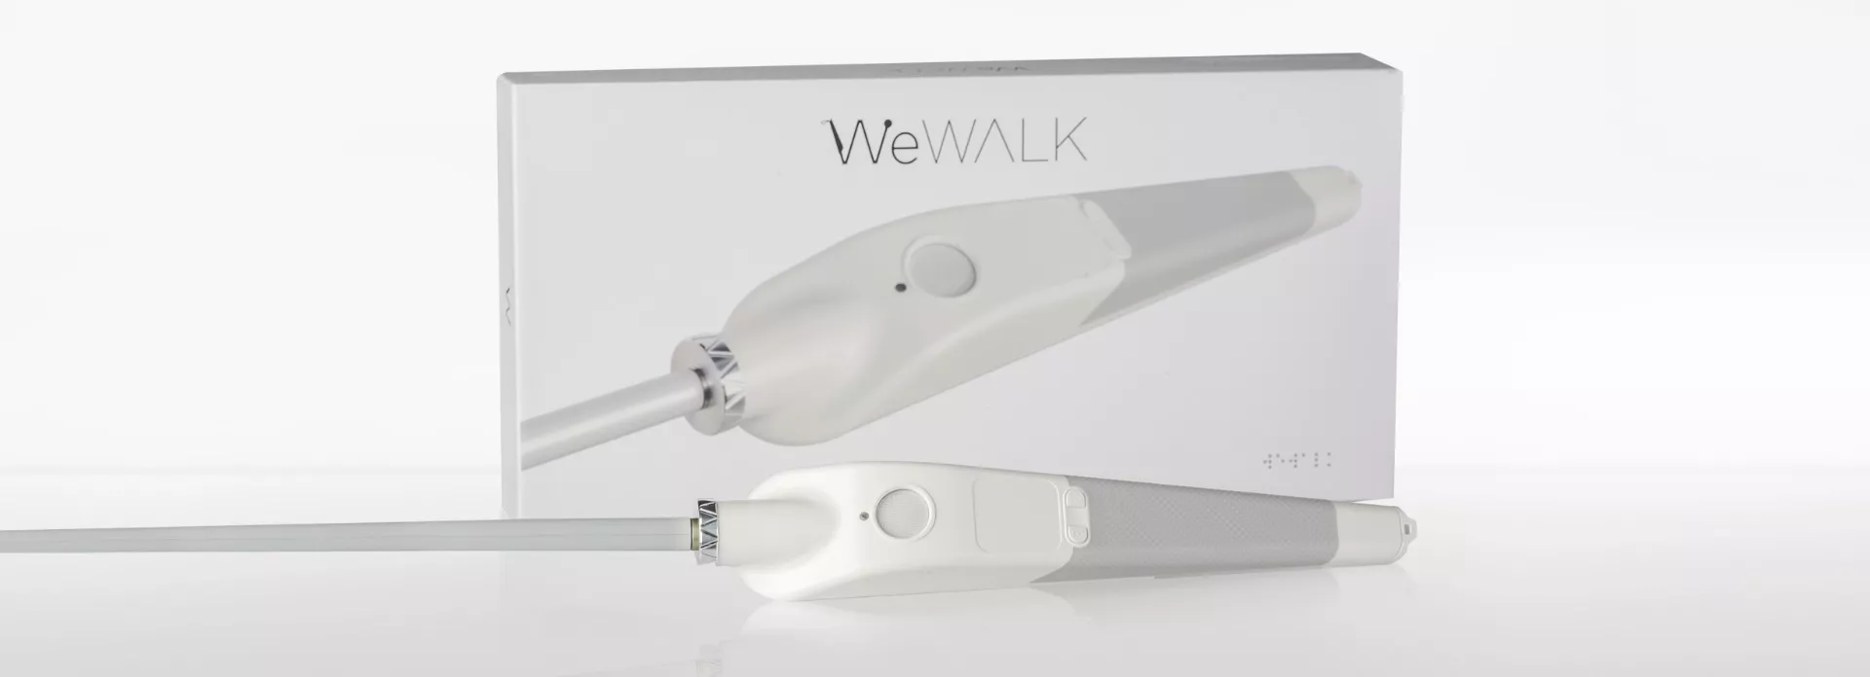
WeWalk smart stick
IIT DELHI’S SMART CANE

Slide 15
WHY CHOOSE US?
WE HAVE MORE FEATURES THAN THEM
THE COST AND CAUSE.

Slide 16
OUR EXPECTED ESTIMATE
With some analysis on
MARKET DEMAND
MANUFACTURING COSTS
DISTRIBUTION AND MARKETING COST
SENSIVITY TO PRICE

Slide 17
THE APPROXIMATE PROTOTYPE COST

Slide 18
THE PROTOTYPE - COST
We found that the total investment for this smart cane to be approximate around 10,000 INR which was shown in a price split up pie chart

Slide 19
THE ACTUAL EXPENDITURE AND PROFIT ANALYSIS
FOR 100 UNITS produced in a month :
The Apprx. Expenses are shown below
The actual product development and prototype cost = 6,50,000 INR (6500/unit)
The Space and utilities = 2,00,000 INR
Salaries/Wages = 1,50,000 INR
Insurance , legal and accounting = 30,000 INR
Technology and software = 10,000 INR
= 10,40,000 INR
THE SELLING PRICE OF OUR SENSEI STICK IS EXPECTED TO BE AROUND 15,000 INR

Slide 20
PROFIT MARGIN?

Slide 21
The profit margin if there is a sell-through?
Imagining a situation where all the units which are made are made to sell to the end consumers after they are been sold to the retailer or distributor , The profit margin may rise upto 40%.
This can or may happen when we sell or distribute the units to an NGO or a govt. run organization .

Slide 22
HOW DO WE PLAN TO MARKET THIS?
As per our research and analysis from the availability of govt. schemes and NGO’s we found some actively run organizations both governmental and NGO’s
Some of them are
Mitra project ( have been giving employment over 26years)
NABET (National association for blind employment and training)
Sarthak edu trust (Placed 10,000+ VIP’s in IT,BPO,RETAILS)
Kahani project

Slide 23
PARTNERING WITH GOVT. & NON-GOVT ORG
The potential we found to have at being a partnering /collaboration with govt and NGO’s seem to be helpful in the context of marketing our product are
Cost spent for targeted marketing is reduced
Will be eligible for perks like funding and other various policies
Better understanding of local market
Increase in credibility
Enhanced distribution channels

Slide 24
HOW WILL WE FUND OUR PROTOTYPE?
The first initial stage of funding may be from a seed fund from any organization or we can plan on completely bootstrapping the startup.
The above will pave the way for future attraction of investors or venture capitalists

Slide 25
USP – UNIQUE SELLING PROPORTION
With enough light on ROI and financial projections , addressing the USP is a must
ENHANCED SAFETY : This device is not meant to be a complete guide but it is made to enhance the security and to provide a companion like experience to the visually impaired.
CONVENIENCE : The usage of haptic and audio feedback spaced at a proper interval without repetition and a controlled intensity , it can also be very handy if the user has any mobility challenges

Slide 26
USP – UNIQUE SELLING PROPORTION
REAL TIME UPDATES : The feature that sends live map updates can be a valuable tool for caretakers and family members to keep track of the user's location, providing them with peace of mind and allowing for quick responses in case of emergencies, also the update is not as fast, with an intentional delay it is first verified whether the user is picking up the stick, else the alert is sent to the nearby policestation/ambulance.
FUTURE INTEGRATIONS AND COMPATIBILITY: Since this device is built with an internet enabled SoC , with OTA updates we can push new updates to the device and can have compatibility with other wearables and widely Smartphones.

Slide 27
FINANCIAL PROJECTION
Month 2:
Units produced: 110 (10% increase from previous month)
Revenue: 110 x 15,000 = 16,50,000 INR
Expenses:
Product manufacturing cost: 7,15,000 INR (6500 x 110 units)
Space and utilities: 2,00,000 INR
Salaries/Wages: 1,50,000 INR
Insurance, legal, and accounting: 30,000 INR
Technology and software: 10,000 INR
Total expenses: 11,05,000 INR
Profit: 16,50,000 INR - 11,05,000 INR = 5,45,000 INR

Slide 28
Month 3:
Units produced: 121 (10% increase from previous month)
Revenue: 121 x 15,000 = 18,15,000 INR
Expenses:
Product manufacturing cost: 8,66,500 INR (6500 x 121 units)
Space and utilities: 2,00,000 INR
Salaries/Wages: 1,50,000 INR
Insurance, legal, and accounting: 30,000 INR
Technology and software: 10,000 INR
Total expenses: 12,56,500 INR
Profit: 18,15,000 INR - 12,56,500 INR = 5,58,500 INR

Slide 29
MONTH 4:
Units produced: 133 (10% increase from previous month)
Revenue: 133 x 15,000 = 19,95,000 INR
Expenses:
Product manufacturing cost: 8,64,500 INR (6500 x 133 units)
Space and utilities: 2,00,000 INR
Salaries/Wages: 1,50,000 INR
Insurance, legal, and accounting: 30,000 INR
Technology and software: 10,000 INR
Total expenses: 12,54,500 INR
Profit: 19,95,000 INR - 12,54,500 INR = 7,40,500 INR

Slide 30
Will India be suitable for this?
As per our analysis on the past data and the expected trend in visual impairment this product can seem to have good response
As quick it cant get into a mainstream market ,unless it can be promoted through small community groups, NGO’s and some governmental organizations

Slide 31
STATS OF INDIA
Currently, there are an estimated 4.95 million blind persons and 70 million vision impaired persons in India, out of which 0.24 million are blind children

Slide 32
THE GENERAL PIECHART OF POPULATION PERCENTAGE

Slide 33
THE CATEGORY WHICH IS UNSPOKEN

Slide 34
HAPPY INDEPENDENT LIVING.

